Slide 1
Skip a sheet of paper.
Then write your bellwork

Slide 2
Copy bellwork: Key terms & Concepts to Know:
9/30/13
Chapter 2: What were the causes and effects of the European exploration of the Americas?
Bellwork 1. Empire = an extensive group of states or countries under a single supreme authority.
2. Territory = an area of land under the jurisdiction of a ruler or state.

Slide 3
Copy bellwork: Key terms & Concepts to Know:
10/1/13
Chapter 2: What were the causes and effects of the European exploration of the Americas?
Bellwork:
Montezuma = Aztec Ruler, mistook Cortes to be a god and welcomed him into the empire. Offered him gifts, but was killed nonetheless.
Mercantilism = The belief that colonies existed to make the home country wealthy and powerful.
The Northwest Passage = A water route to Asia through North America sought by European explorers. It went from the Atlantic to the pacific Ocean.

Slide 4
Homework
9/30/30 Take notebook home.
Finish drawing and coloring cover. Use the textbook or google to help your color.
Color the European map. Use different colors for each country.
10/1/13
Online: Do 2.1 know it show it and multiple choice.
Text: write key words and definitions 2x on bottom of page 36

Slide 5
Draw INBK Cover
Follow chart instructions.
You are drawing the flags of:
Spain
England
France
The Netherlands

Slide 6
Chapter 2: Europe looks outward , pages 36-57

Slide 7
Label European Countries on Map
Directions:
1) label the countries on map.
2) Glue map on LEFT SIDE
Color at home.
Spain- Red
Italy –green
England – blue
France – yellow
The Netherlands -purple
Spain
Italy
England
France
The Netherlands

Slide 8
Map of Spain
Spain looks like a head. They Speak Spanish. Portugal looks like the face.

Slide 9
Map of Italy
Italy looks like boot. It is located in the continent of Europe. They speak Italian. Columbus was born here.

Slide 10
Map of England
England is a small, but powerful country located in European continent. They speak English.

Slide 11
Map of France
A country in European continent. They speak French. Located between England and Spain.

Slide 12
Map of the Netherlands
A small country located in the European continent. They speak Dutch. They are located above France. Their flag looks like the French.

Slide 13
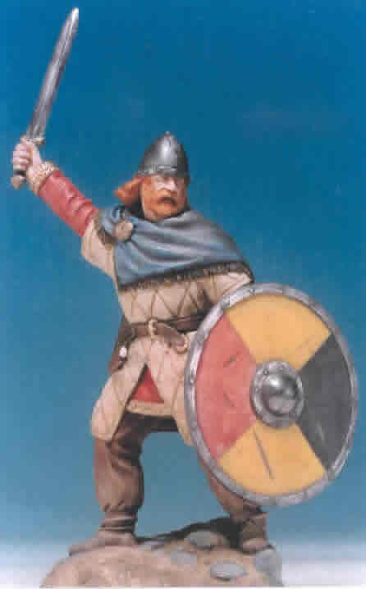
Section 1: The Age of Exploration
The Vikings set up a temporary colony in Newfoundland.
They reached
the Americas
before Columbus.

Slide 14
Christopher Columbus, seeking a sea route to Asia, reached the West Indies or America in 1492 instead. He thought he reached an island in Asia.

Slide 15
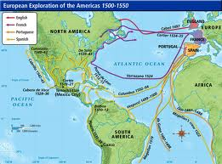
European Explorers continued to explore and colonize the Americas.

Slide 16
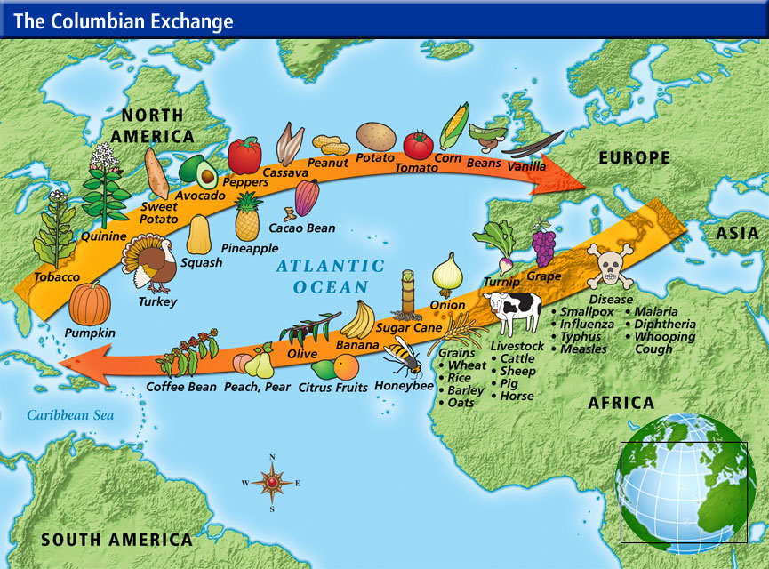
The Columbian Exchange resulted in the transfer of products, people and ideas between Europe and the Americas.

Slide 17
Section 1 Review
Answer these question on left side.
1. Why Columbus wanted to find a faster route to Asia?
2. Did he find it?
3. What other European countries joined the explorations and colonized the Americas?

Slide 18
Section 2: Spain’s Empire in the Americas

Slide 19
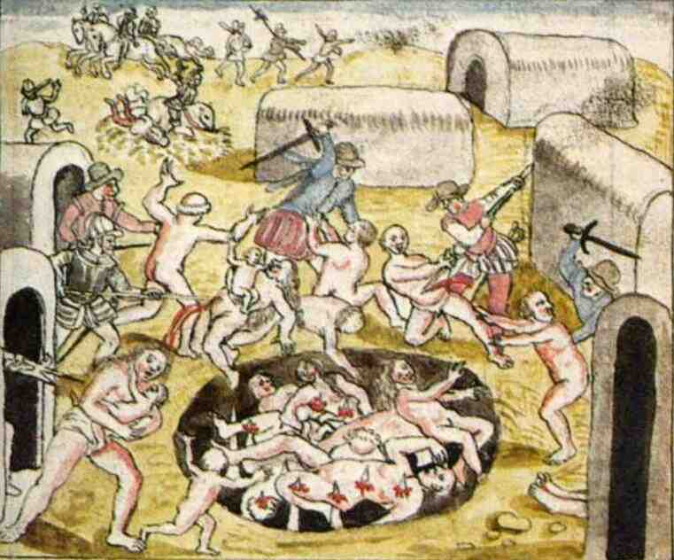
Spanish conquistadors conquered Native Americans

Slide 20
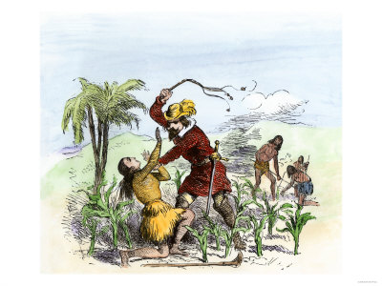
As the Spanish empire grew, Native Americans workers were harshly treated.

Slide 21
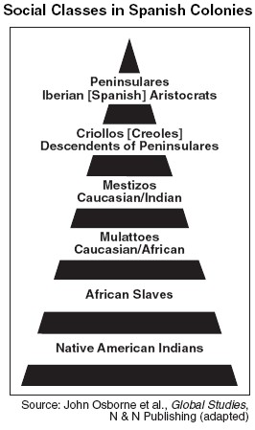
A strict class system developed in Spain’s American colonies.

Slide 22
Section 2 Review
Answer these questions on left side.
4. What Spain wanted from Native Americans?
5. How did conquistadors treated Native Americans? Give details.

Slide 23
Section 3: Europeans Compete in North America

Slide 24
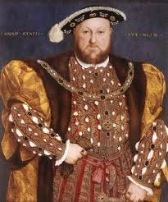
During the Reformation, the authority of the Roman Catholic Church was challenged.
English Protestants found a supporter in King Henry VIII who left Roman Catholic Church and turned England into a Protestant country.

Slide 25
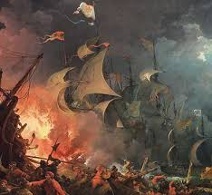
Spanish Armada, Spanish war ships.
The defeat of the Spanish Armada by England undermined Spain's control of the seas. As a result Spain loses American colonies.

Slide 26
European explorers continued to seek a northwest passage to Asia

Slide 27
Section 3 Review
Answer this question on left side.
6. What was the Spanish Armada?

Slide 28
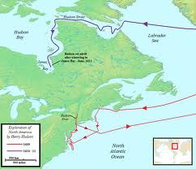
Section 4: France and the Netherlands in North America
Dutch Exploration

Slide 29
French colonists in New France established a fur trade with Native Americans.
What do you think is happening in the picture?

Slide 30
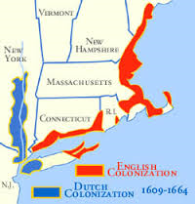
The Dutch established permanent settlements in what is now northern United States.

Slide 31
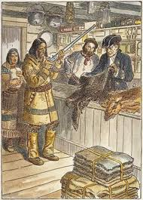
The French and Dutch settlements has a negative impact on Native Americans.
Different Native American tribes stared to compete and fight. The Native Americans friends of the French against the Native American friends of the Dutch.
Killed by diseases brought by French and Dutch
Too many animals killed over fur.

Slide 32
Section 4 Review
Answer this question on left side.
7. What kind of trade did the North Native Americans had with the French?
8. Did the relationship with the French and Dutch had a negative effect on Native Americans? If yes, how?

Slide 33
Ticket out the door:
What stuck with you from chapter 2 PPT? (Age of Exploration, Spain’s Empire in the Americas; European Compete in the Americas; The French and Dutch in North America)

